Slide 1

The Lightning Network
Thunderstruck!

Slide 2
Update!
https://www.youtube.com/watch?v=HPuRMXGdBjo&feature=youtu.be

Slide 3


Alex Melville
Software Engineer @BitGo
Digital Nomad
github.com/Melvillian

Slide 4
Main Goal: How to use the Lightning Network
What immediate problems does Lightning solve?
What will Lightning allow us to do that we can’t do now?
What is Lightning?
RPC commands to operating lnd
How does Lightning work?
Future use of Lightning: Neutrino
Readings for future study

Slide 5



Transaction Scalability:
Transactions per second (TPS)
Average: 2000
Peak: 56,000
Average: 4
Peak: 7
Average*: 8
Peak: 14
Average: 200
Peak: 400
50x

Slide 6
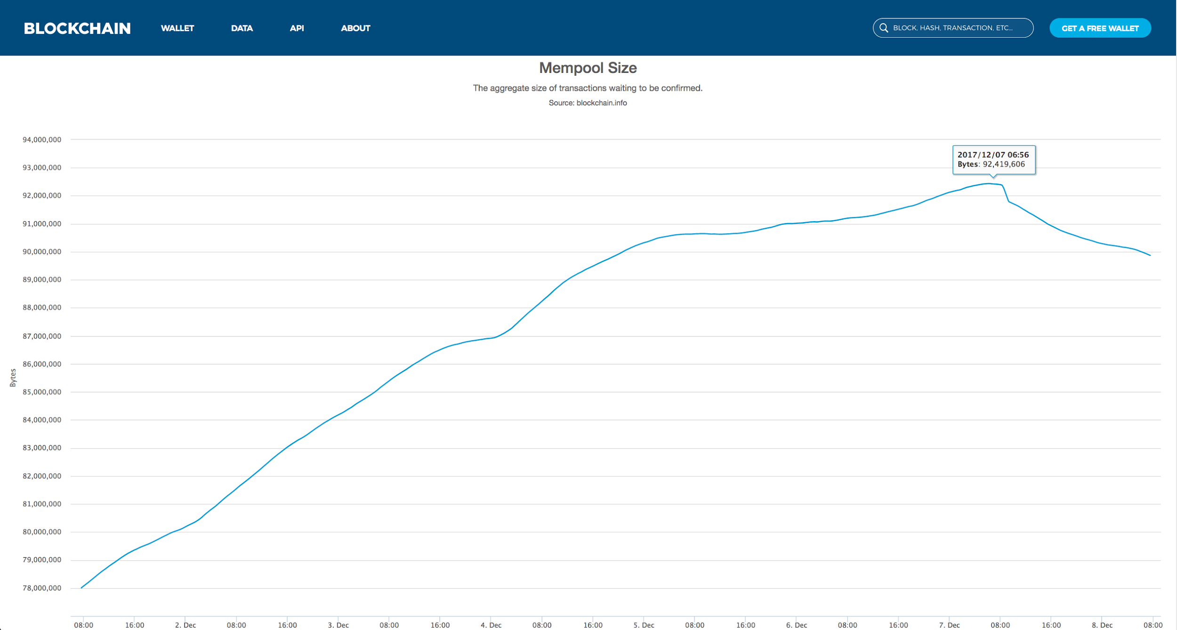
Transaction Backlog

Slide 7

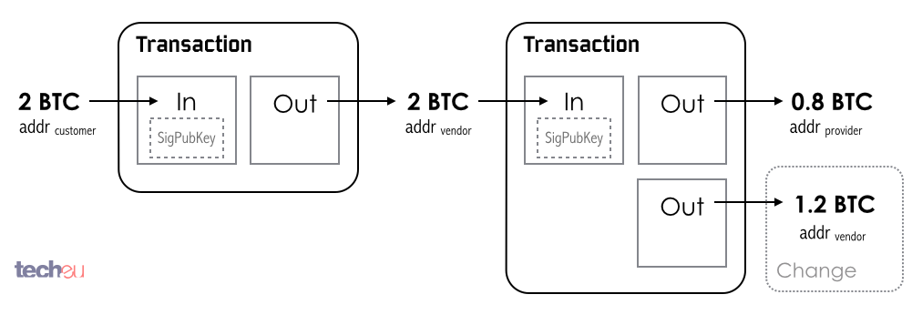
How does it scale?
Removes the need to make on chain transactions for payments.
User wallets manage a smart contract with several payment nodes
The contract is fully backed by bitcoin, but can be updated locally between the two nodes
Contract updates can be chained so any connected node can pay any other.
Rarely need to talk to him
Especially if we know 100% what he will decide

Slide 8
Light Clients & Contract Enforcement
Light clients are users of the bitcoin ecosystem that do not download and verify the whole blockchain
We aspire that light clients do not trust, current wallets work by
Comparing headers with difficulty
Bloom filters
Merkle Trees
Compact block filter headers
Reverses the filter dynamic
Trust model changes when you are managing payment channel contracts
We can outsource channel monitoring

Slide 9
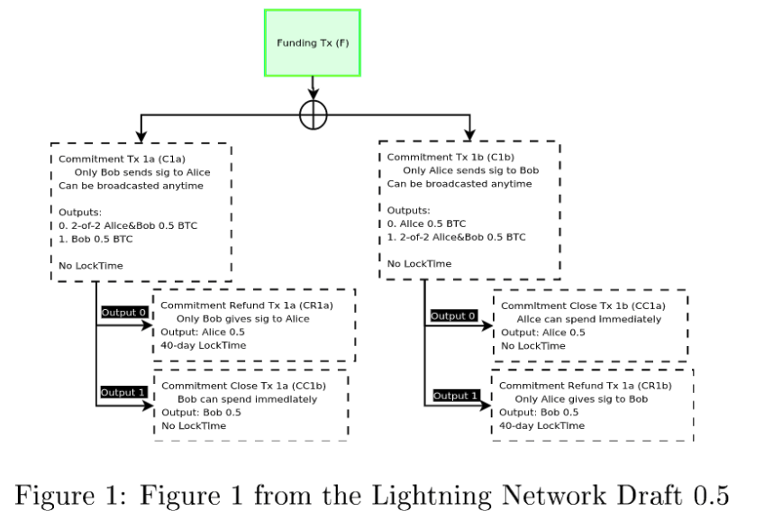
Poon-Dryja Channel:
Each side of the channel maintains it’s own version of transactions

Slide 10
Future Improvements from Lightning
Instant Payments to anyone

Slide 11
Future Improvements from Lightning
Micropayments

Slide 12
Future Improvements from Lightning
Cross-chain Atomic Swaps

Slide 13
Break...

Slide 14
So….
What is Lightning?

Slide 15
Think of Lightning as a System of Secure IOUs
Alice
Block
Bob
Block
Block

Slide 16
Think of Lightning as a System of Secure IOUs
Block
Block
Block

Slide 17
Think of Lightning as a System of Secure IOUs
Funding
Tx
Block
Block
Closing
Tx
Block

Slide 18
What does Lightning Look Like?
lncli
Command-line client used to send JSON-RPC requests to lnd (written in Golang)
lnd
Lightning-aware node which handles channel management, private/public key storage, and peer communication. Used btcd to interact with blockchain (both are written in Golang)

Slide 19
What does Lightning Look Like?
Download + install lnd + lncli
https://github.com/lightningnetwork/lnd/blob/master/docs/INSTALL.md

Slide 20
What does Lightning Look Like?
Download + install lnd + lncli
https://github.com/lightningnetwork/lnd/blob/master/docs/INSTALL.md
Create lnd wallets
lncli create
lnccli unlock

Slide 21
What does Lightning Look Like?
Download + install lnd + lncli
https://github.com/lightningnetwork/lnd/blob/master/docs/INSTALL.md
Create lnd wallets
lncli create
lnccli unlock
Fund Wallets

Slide 22
What does Lightning Look Like?
Download + install lnd + lncli
https://github.com/lightningnetwork/lnd/blob/master/docs/INSTALL.md
Create lnd wallets
lncli create
lnccli unlock
Fund Wallets
Create Payment Channel
lncli connect 033f05189c200b946097ed0a81e1d47ec1b83ba5343670d1500659ac74be21de51@159.203.125.125
lnccli openchannel --node_key=033f05189c200b946097ed0a81e1d47ec1b83ba5343670d1500659ac74be21de51 --local_amt=100000000

Slide 23
What does Lightning Look Like?
Send funds!
lncli addinvoice --value=1000
"pay_req": "lntb100u1pdza8wmpp570kl3xp8psz4enjcxrlv66xmssj044hfe37nntd9waq0rwjs0hlqdqqcqzystdrasw9ufy30q9dv9awa0tw2lurm9dgw4updpk4dlx4hz4jugf65454usjmyu9w6vrj6tny7fw4uz56x3x2q6c6q2wgwfq9hapyz4ugqhedxqu"
lncli sendpayment --pay_req=lntb100u1pdza8wmpp570kl3xp8psz4enjcxrlv66xmssj044hfe37nntd9waq0rwjs0hlqdqqcqzystdrasw9ufy30q9dv9awa0tw2lurm9dgw4updpk4dlx4hz4jugf65454usjmyu9w6vrj6tny7fw4uz56x3x2q6c6q2wgwfq9hapyz4ugqhedxqu
Side-note: Lightning in it’s current form is pull-based, you can’t send funds to nodes without them first requesting you send them (different from underlying Bitcoin way of sending, which is push-based)

Slide 24
What does Lightning Look Like?
Close the channel
lncli closechannel --funding_txid=5fb65faf5ef665284bd82db5077b26d8eb3617cdb7e143a6bbef4e6301b41221 --output_index=0

Slide 25
What does Lightning Look Like?
Demo!

Slide 26
What does Lightning Look Like?
Demo!
...come up and talk afterwards

Slide 27
Break...

Slide 28
How Does Lightning Work?

Slide 29
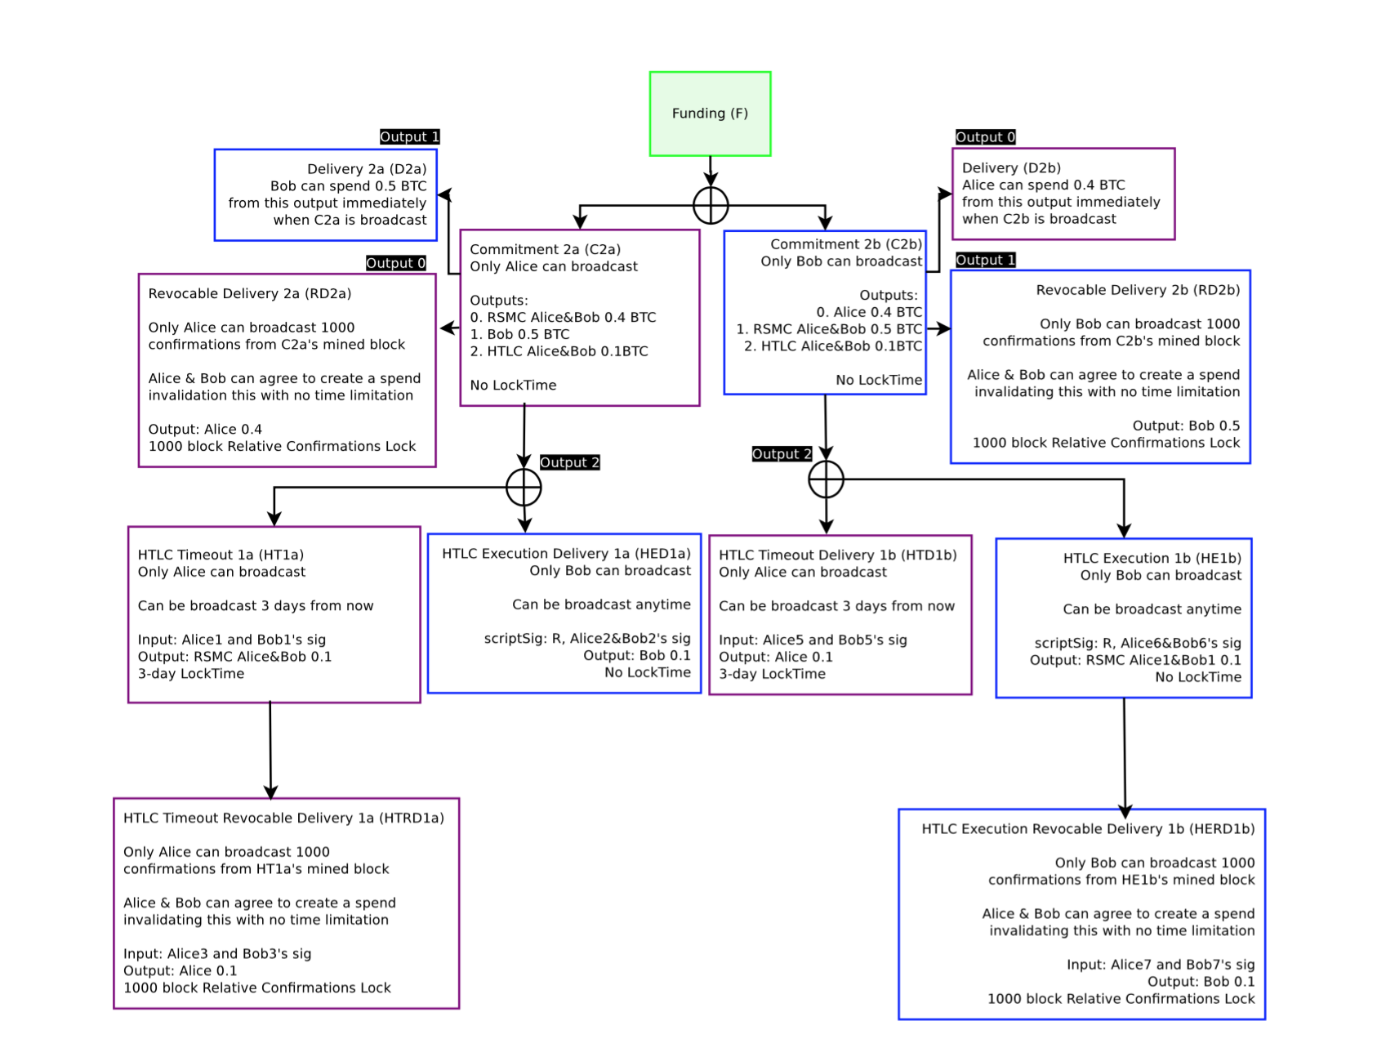
How Does Lightning Work?

Slide 30
How Does Lightning Work?
Smart Contracts (Bitcoin SCRIPT language)
Multisignature addresses
Funding transaction
Commitment Transactions
Time-locked Transactions
Revocation Transactions
Hash Time-locked Transactions

Slide 31
Smart Contracts (SCRIPT)
Addresses are not what you think they are
Addresses are mini programs which, if upon ending return TRUE, prove ownership of coin
Address -> scriptPubKey (like a callback)
Ownership -> scriptSig (like arguments to the callback)
scriptPubKey: OP_DUP OP_HASH160 <pubKeyHash> OP_EQUALVERIFY OP_CHECKSIG
scriptSig: <sig> <pubKey>

Slide 32
Funding Transaction
Used to open/fund the the Alice-Bob channel
Alice and Bob each generate a keypair
Broadcast the transaction to the blockchain, wait for it to confirm
Happens after Commitment transactions are exchanged
2-2 multisig address
Requires 2 signatures, one from Alice, one from Bob, in order to be valid
Ensures both Alice and Bob must agree before moving any funds
Uses P2SH (Pay to Script Hash) address types
scriptPubKey: 2 <alicePubKey> <bobPubKey> 2 OP_CHECKMULTISIG
scriptSig: OP_0 <aliceSignature> <bobSignature> 2 <alicePubKey> <bobPubKey> 2 OP_CHECKMULTISIG

Slide 33
Commitment Transaction
Represents the current state of the channel
How much coin do Alice and Bob have
Protects Alice and Bob from being hurt if either is uncooperative
If broadcasted, broadcaster must wait some time before claiming funds, but other channel member can claim their funds immediately
OP_IF # Penalty transaction <revocationkey> OP_ELSE `to_self_delay` OP_CSV OP_DROP <local_delayedkey> OP_ENDIF OP_CHECKSIG

Slide 34
Future Study
Master resource list (you will know more than me after watching/reading all of this)
http://dev.lightning.community/resources/
Mid-level explanation of Lightning
http://dev.lightning.community/tutorial/01-lncli/index.html
Summaries of major BOLTs (Lightning’s version of BIPs) by core dev Rusty Russell
https://medium.com/@rusty_lightning/the-bitcoin-lightning-spec-part-1-8-a7720fb1b4da
Tutorial on how to setup 3 lightning nodes and make payments
http://dev.lightning.community/tutorial/01-lncli/index.html
API docs for lnd
http://api.lightning.community/
Original Lightning Network Whitepaper
https://lightning.network/lightning-network-paper.pdf

Slide 35
Further Future Study
Core Lightning Developer Blog
https://rusty.ozlabs.org/?p=462
Good SO post explaing Lightning
https://bitcoin.stackexchange.com/questions/48283/what-is-the-lightning-network-proposal-what-problem-is-it-trying-to-solve
Transaction Timelock Explanation
https://en.bitcoin.it/wiki/Timelock
2015 Explanation of Lightning Network (useful when trying to understand what’s changed)
https://github.com/ElementsProject/lightning/blob/master/doc/deployable-lightning.pdf

Slide 36
Further Watching
https://www.youtube.com/watch?v=7FWKc8lM4Ek

